Slide 1
Technology for Success: Computer Concepts

Slide 2
Module 10
Networking

Slide 3
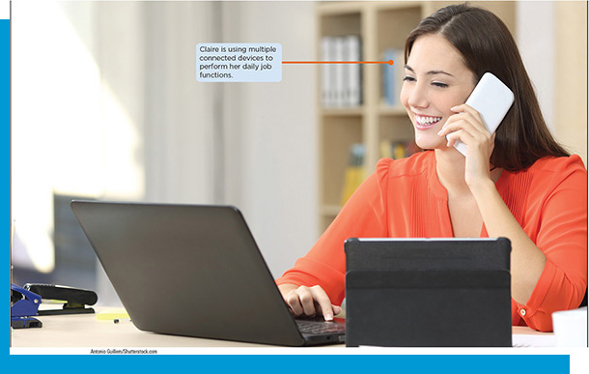
Lesson Objectives
Discuss the key features of connected networks and explore how connections between networks are made
Discuss issues of equity and safety in a connected world
Connect to different types of networks

Slide 4
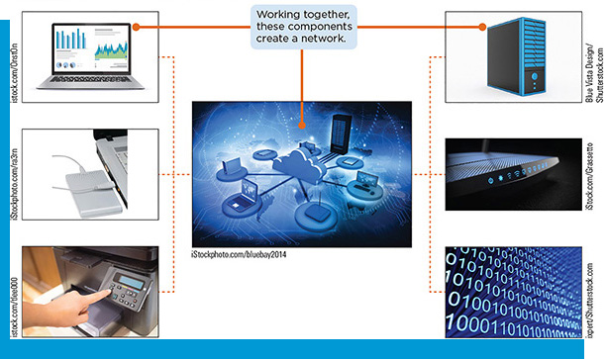
Key Features of Connected Networks
Explain how a network operates
Define the elements of a connected network
Identify the devices necessary to create a network
Explain the physical connections between networks and network parts
Explain the differences between various types of networks

Slide 5
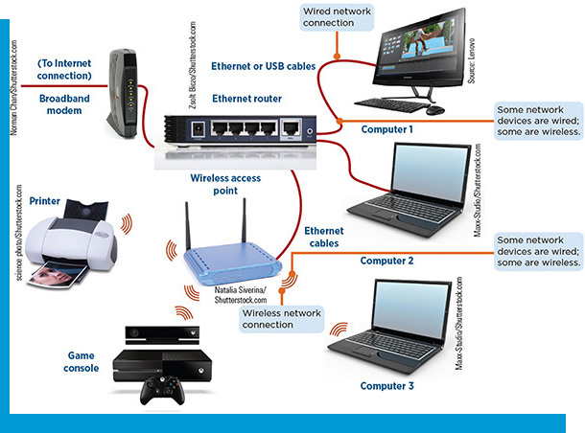
How a Network Operates
A network is a system of two of more devices linked by wires, cables, or a telecommunications system
Requires a combination of hardware and software
Some networks provide connections to the Internet, which requires the services of an Internet Service Provider (I S P)
Enables the network to communicate with other networks that are also connected to the Internet

Slide 6
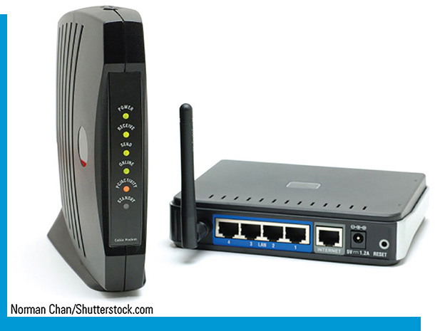
Elements of a Connected Network
Hub: transfers all data to all devices
Switch: transfers data only to the intended recipient
Router: device that connects two or more networks
Modem: communications device that connects a communications channel to a device
Connects the network to the Internet through an I S P
Two main network types: home and business

Slide 7
Devices Necessary to Create a Network
Requires two or more devices that need to communicate, a way to communicate, and the infrastructure to facilitate the communication
A network interface card (N I C) is required for a computer to connect to a network
Cable modem/D S L modem

Slide 8
Physical Connections Between Networks (1 of 3)
Table 10-1: Network Topologies
Topology | Details | Network arrangement
Bus network Wires on which data travels to and from the CPU. | All devices attach to a central cable, called a bus, which carries the data. If the bus fails, the devices on the network will no longer be able to communicate.
Ring network | Data travels from one device to the next in a sequential fashion. If one device on the network fails, communication on the network could cease to function. Ring networks are no longer common.
Star network | Each device on the network is attached to a central device such as a server or switch. If the central device fails, the other devices will be unable to communicate. If a connected device fails, all other devices will still be able to communicate. Two or more star networks may be joined together using a bus to form a tree topology. Tree topologies often are used in schools and businesses.
Mesh network | All devices interconnect with each other. If a single device on the network fails, the rest of the network will continue to function by communicating via an alternate route. Two types of mesh topologies are a full mesh topology (each device on the network is connected to every other device on the network) and a partial mesh technology (each device may or may not be connected to all other devices on the network).

Slide 9
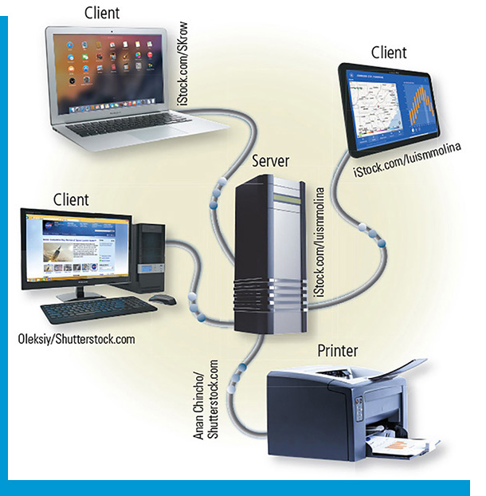
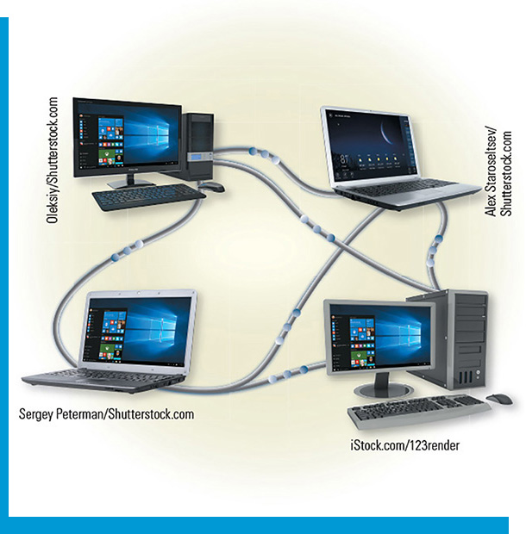
Physical Connections Between Networks (2 of 3)
Network Architecture
Determines the logical design of all devices on a network
Client/server network
Peer-to-peer (P2P) network
Cloud computing

Slide 10
Physical Connections Between Networks (3 of 3)
Geographic Reach
Local area network (L A N) connects computers and devices in a limited area
Wide area network (W A N) connects devices in a large geographic region
Metropolitan area network (M A N) is operated by a city or county
Personal area network (P A N) connects personal digital devices within 30 feet via Bluetooth
Body area network (B A N) small, lightweight biosensors implanted in the body

Slide 11
Differences Between Various Types of Networks
Table 10-2: Additional Network Types
Network type | Description
Wired network | Sends signals and data through cables, which may have to travel through floors and walls to connect to other network devices. Wired networks tend to be more secure and transmit data faster than wireless networks.
Wireless network A type of printer or other device that is connected to either a wired or wireless network to which you have access. | Sends signals through airwaves, and usually do not require cables. Wireless networks tend to be more convenient and easier to set up than wired networks, but can be less secure. Wireless networks make it possible to connect devices in locations where physical wiring is not possible or is difficult.
Intranet An internal network site used by a group of people who work together. | A private network for use by authorized individuals. Organizations use intranets to communicate internally and can allow users to use a web browser to access data posted on webpages. Intranets are preferable when data being transferred should not necessarily reach the Internet.
Extranet | Allows outsiders (such as customers, vendors, and suppliers) to access an organization’s intranet. For example, an extranet might be used if a supplier needs to check a customer’s inventory levels before deciding whether to ship additional product.
Virtual private network (V P N) | A private, secure path across a public network that allows authorized users secure access to a company or other network. A V P N can allow an individual to access an organization’s network by using encryption and other technologies to secure the data transmitted along the path.

Slide 12
Discuss Issues of Equity and Safety in a Connected World
Identify the risks and benefits associated with using a connected network
Explain how unauthorized network use threatens communication technology
Explain how to secure a network
Secure data stored on a network
Explain how to encrypt a network
Explain the pros and cons of net neutrality

Slide 13
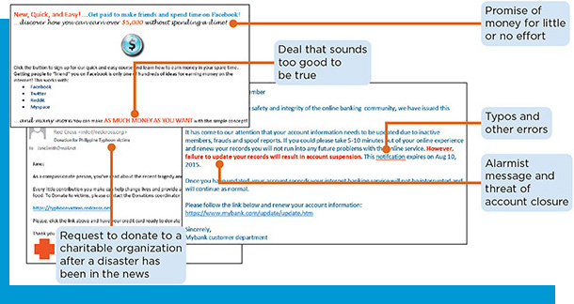
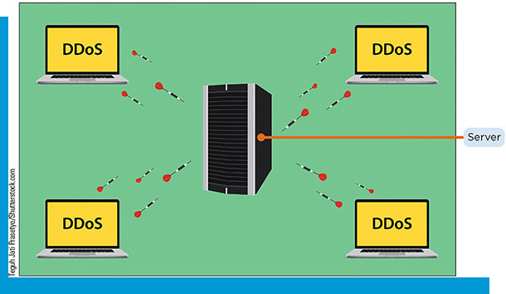
Risks and Benefits with Using a Connected Network
Benefits: sharing resources without regard to geographic location; easier communication
Risks
Malware can install itself without permission and damage or steal data from a computer or device
Hackers can gain access to personal data
Phishing
Social engineering
Denial of service (D o S) attack
Distributed denial of service (D D o S) attack
Zombie

Slide 14
How Unauthorized Network Use Threatens Communications
When hackers can connect to the same network as the computer they wish to target, it is easier to obtain information
Data also might be exposed by connecting to a fraudulent network
When connecting to a public Wi-Fi network, one should not enter confidential information on websites or send personal data in email
Evil twin

Slide 15
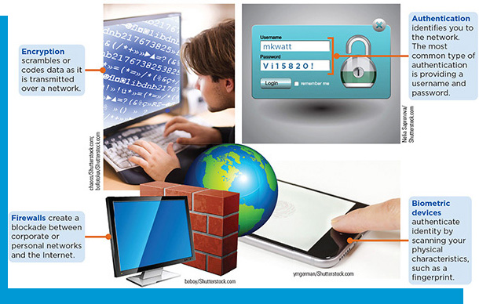
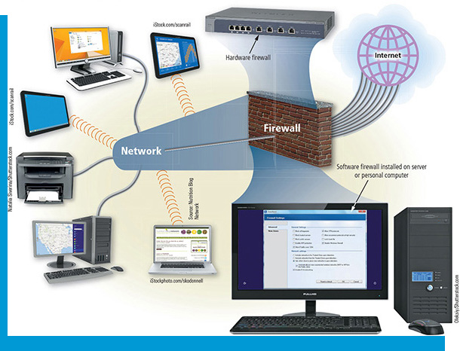
How to Secure a Network
Authentication
User name and a strong password
Biometrics
Firewall
Hardware firewalls
Software firewalls
Encryption

Slide 16
Secure Data Stored on a Network
Network attached storage (N A S) devices are hard drives that connect directly to a network and provide a centralized location for storing programs and data on large and small networks
Specify users who can view the files, as well as view and make changes to the files
Turn on network encryption so that information from files being transmitted on the network cannot be intercepted by others

Slide 17
How to Encrypt a Network
Encryption is the process of converting data so that it is unrecognizable when it is trans- mitted on a network or stored on a storage device, except to users who enter the correct password
Ensure that wireless networks support encryption so that data cannot be intercepted easily by others
Encrypted wireless networks often use a wireless network key to encrypt data sent between devices
One common type of encryption on home routers is W P A2

Slide 18
Pros and Cons of Net Neutrality
When net neutrality is enforced, I S Ps must provide the same level of service to all websites, regardless of their content or purpose
Pros:
Access to websites cannot be restricted based on factors such as content or bandwidth requirements
Cons:
The ability for users to access high-bandwidth content might result in slower Internet speeds for others who are also connecting to the Internet using the same I S Ps
Without net neutrality, I S Ps could charge more for those wanting access to content requiring more resources and less to those who require access to less resource-intensive services

Slide 19
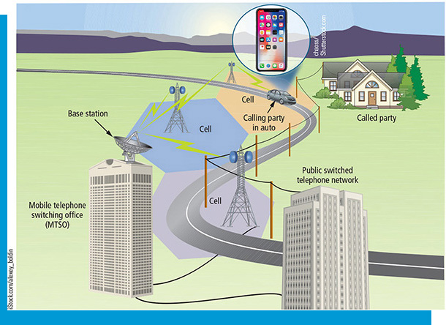
Connecting to Different Types of Networks
Explain how to follow network standards and protocols
Connect to network devices

Slide 20
Following Network Standards and Protocols (1 of 3)
Table 10-4: Network Standards
Network standard | Common use
Ethernet | Most wired networks
Power over Ethernet (P o E) | Devices requiring network connectivity and power to be supplied by the network
Phoneline/HomePNA and Powerline | Networks using telephone lines to connect computers and devices
Wi-Fi | Home and small business networks
L T E | Voice and data transmission on cellular networks

Slide 21
Following Network Standards and Protocols (2 of 3)
Computers communicating with each other on a network must follow a common set of rules for exchanging information, or protocols
T C P/I P (Transmission Control Protocol/Internet Protocol)
Cellular Networks: millions of people use their mobile phones to access the Internet
Cellular networks can provide Internet services in most locations where cellular service is offered
4G and 5G networks provide higher speed data transmission

Slide 22
Following Network Standards and Protocols (3 of 3)
Table 10-5: Close-Distance Network Protocols
Network protocol | Common use
Bluetooth | Devices communicating with each other over a short range (usually less than 30 feet/9 meters)
R F I D (radio frequency identification) | Radio signals transmitted through antennas, often found in tollbooth transponders or embedded chips in animals
N F C (near field communication) | Used in credit cards, smartphones, and tickets to facilitate close-range communication
IrDA | Remote controls or other data transmission within close proximity

Slide 23
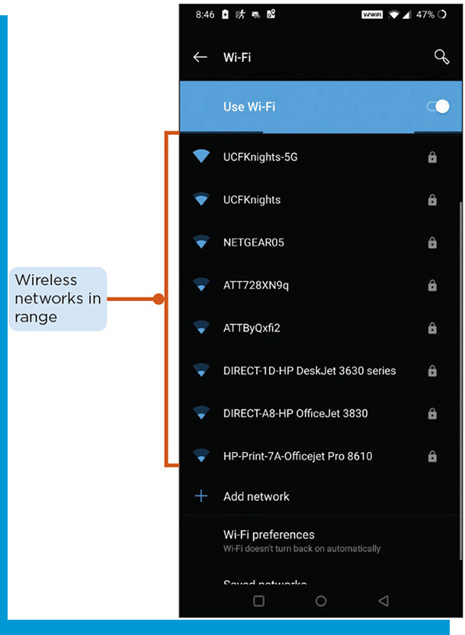
Connect to Network Devices (1 of 3)
Setting up and connecting to a home wireless network: may vary depending on the network hardware, size of home, and devices to be connected.
Purchase a modem or separate wireless router and connect it to your home’s Internet service
Enable the wireless network
Configure a name for the network
Configure a wireless network key
Enable each device’s wireless functionality
On the device, search for and connect to the wireless network
Enter the wireless network key

Slide 24
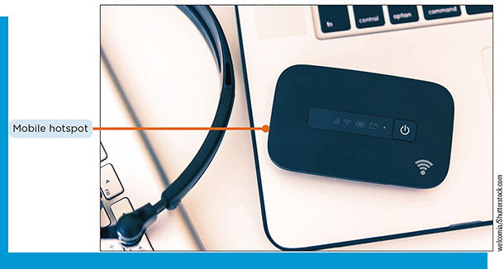
Connect to Network Devices (2 of 3)
Wi-fi hot spots: wireless networks that are available in public places
Mobile hot spots: enables one to connect a phone, computer or other device to the Internet through the cellular network
Many smartphones contain mobile hotspot functionality, although cellular providers may charge an extra fee to use it, and any data transmitted or received through the hotspot will be added to the overall data usage

Slide 25
Connect to Network Devices (3 of 3)
Safety Precautions for Wireless Networks
Change the administrative password for the router
Change the wireless network name from the default
Enable encryption, and choose a secure wireless network key that is difficult to guess
Regularly change your wireless network key
Regularly review the number of devices connect to the network
Enable and configure the M A C address control feature
Choose a secure location for the wireless router
Regularly perform router firmware updates

